Slide 1

Lesson 2: The Theories of Leadership
“A leader takes people where they want to go. A great leader takes people where they
don’t necessarily
want to go,
but ought to be.”
-Rosalynn Carter

Slide 2

1. What is the evolutionary process of leadership theories?
Great man theories were the first attempt in studying leadership.
-Based on the idea that leaders are “born.”
Additional approaches have been developed— trait theories, behavioral theories, and modern-day contingency theories.
Emphasis today is that leadership styles should match the situation at hand, which is a contingency approach.

Slide 3
2. What are the major conclusions of the trait theories?
First major study searched for traits that differentiated leaders from followers.
Researched focused heavily on personality characteristics.
Stogdill/Mann identified five important traits found more in leaders than followers.
Intelligence, self-confidence, determination, integrity, and sociability. Intelligence most important.
Leadership skills can be developed and nurtured.
Organizations need to spend time and resources in training leaders to acquire certain desirable traits.

Slide 4
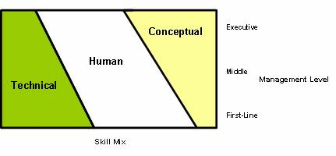
3. What is the skills approach to leadership?
Robert Katz’s research surfaced a set of skills for leadership success.
Skill 1-“Technical skills” involving hands-on activity.
Skill 2 -“Human skills” which is the ability to work with people.
-Greatest asset to have.
Skill 3 -“Conceptual skills” having ability to work with ideas and concepts.

Slide 5
4. What are the major conclusions of the behavioral Theories?
The 1940s saw that leadership effectiveness was dependent upon leader behavior.
Rensis Likert’s Michigan Studies surfaced two forms of leader behavior—job-centered (production) and employee-centered.
-Attempt made to balance task and relationship emphasis.
University of Michigan Studies
Identified 2 Leadership Behaviors
Employee-Centered
Production-Centered
Leaders interested in their subordinates as people, encourage worker participation in the organizational goal-setting process.
Leaders emphasized technical aspects of job, set job standards, close supervision of subordinates.

Slide 6
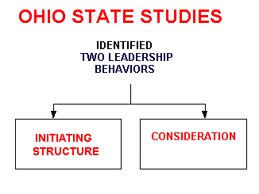
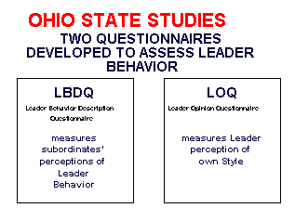
4. Behavioral Theories continued
Ohio State Studies also revealed two leadership forms.
-Used questionnaire to assess employee perceptions of leaders.
-Consideration behavior (concern for feelings).
-Initiating structure (defining roles).

Slide 7
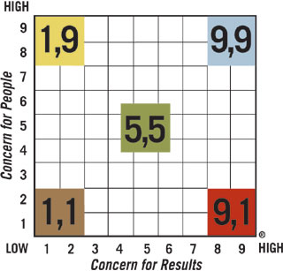
4. Behavioral Theories continued
Managerial/Leadership Grid developed by Blake & Mouton.
-Two dimensions similar to Michigan/Ohio State Studies.
-Concern for subordinates and concern for production/results.
-9.9 is the ideal team approach on grid-balance of task and relationship.
-This research influenced modern contingency approaches of today.
Wren p. 147

Slide 8
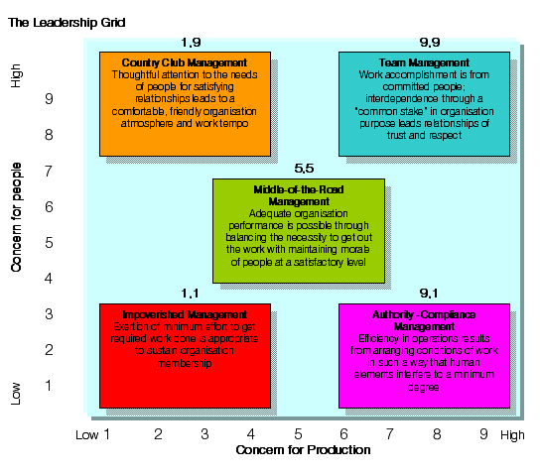

Slide 9

5. What are the major components of the Contingency Theories?
Contingency theory identifies:
-Key situational factors,
-Specifies how they interact, and
-Determines best leadership approach.
-This is called situational leadership.

Slide 10
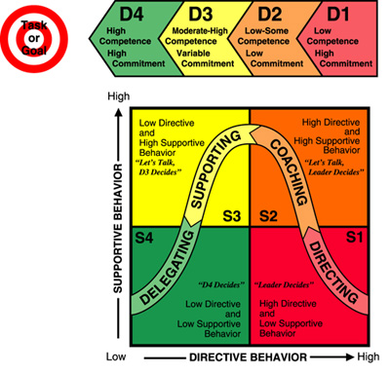
5. Contingency Theories continued
Situational leadership is built upon the contingency theory, and refined by Ken Blanchard in the 1980s.
Leadership is composed of both a directive and supportive dimension.
Coaching and delegating were added to provide four styles.

Slide 11
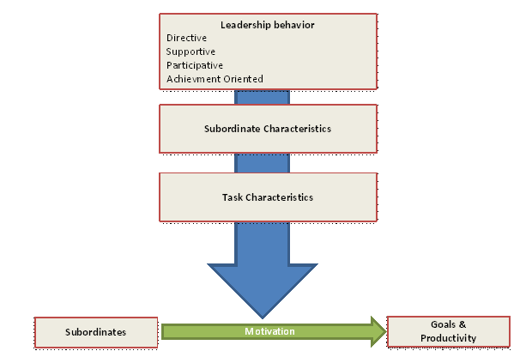
5. Contingency Theories continued
Path-Goal Theory developed by Evans & House.
-Adapting leadership to the situation.
-Leader can impact performance of others by offering paths to desired goals.
-Rewards contingent on increased performance.

Slide 12

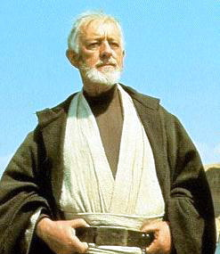


5. Contingency Theories continued
Four leader behaviors:
-Directive: gives specific guidance and direction.
-Supportive: provides assistance.
-Participative: hand-in-hand with subordinates.
-Achievement Oriented: sets challenging goals and has high expectations.
Best style to use is to adapt to the participative leadership style.

Slide 13
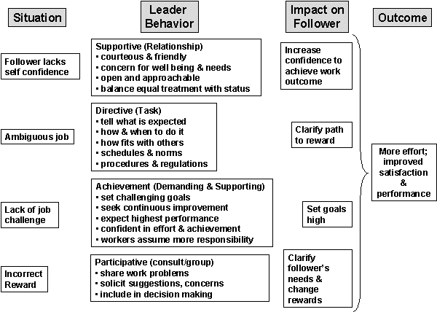

Slide 14
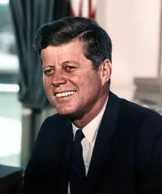
6. Differentiate Between Transactional and Transformational.
Two emerging leadership perspectives:
-Transactional which focuses on leader and follower relationships.
-Transformational (called charismatic) focuses on creating vision, purpose, or mission.

Slide 15
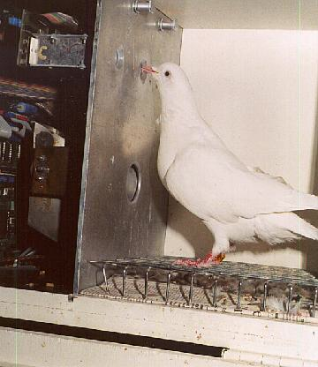
6. Differentiate Between Transactional and Transformational.
Transactional leadership places emphasis on managerial theories (Social-Exchange)
-Keys are role of leader, group, and performance.
-Reward and punishment system.
-Build healthy relationships.

Slide 16
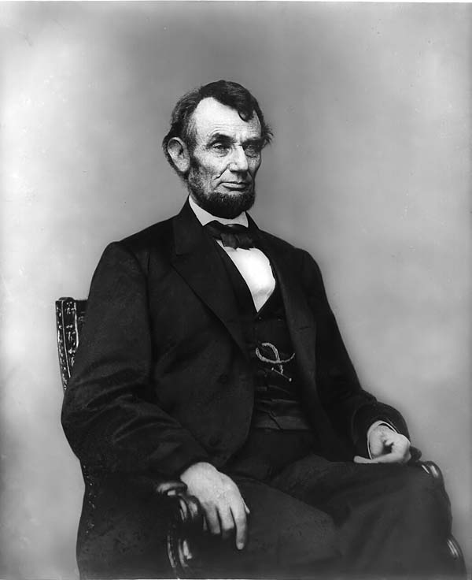
6. Differentiate Between Transactional and Transformational.
Transformational leadership motivates followers to:
-do more than is expected.
-see raised value in tasks.
-put group’s common cause in front of individual needs.

